Slide 1
The Most Productive Teams are Empowered
Chris Hoard

Slide 2



What to expect from this session
Value
Scenarios
Call to action
1
2
3

Slide 3





Defining Empowerment
Empower
Verb
Empower
To give (somebody) the power or authority to do something
Individuals
Frontline Decisions Autonomy
Businesses
Laws Policies
Teams
Skills Knowledge Tools

Slide 4

Microsoft’s Mission and Vision Statement
Mission
Strategic approach to reach the corporate vision
Microsoft
To empower every person and every organization on the planet to achieve more
Vision
Desired future state
To help people and businesses throughout the world realize their full potential

Slide 5




Teams
The Hub for Teamwork
Chat
Files
Meetings and Calling
Apps

Slide 6
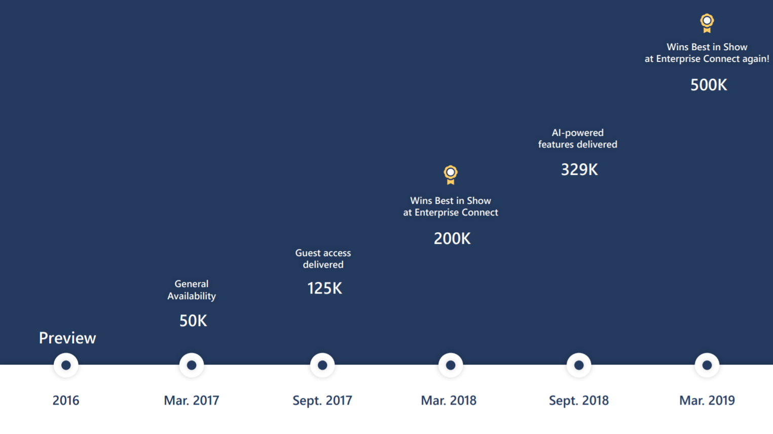
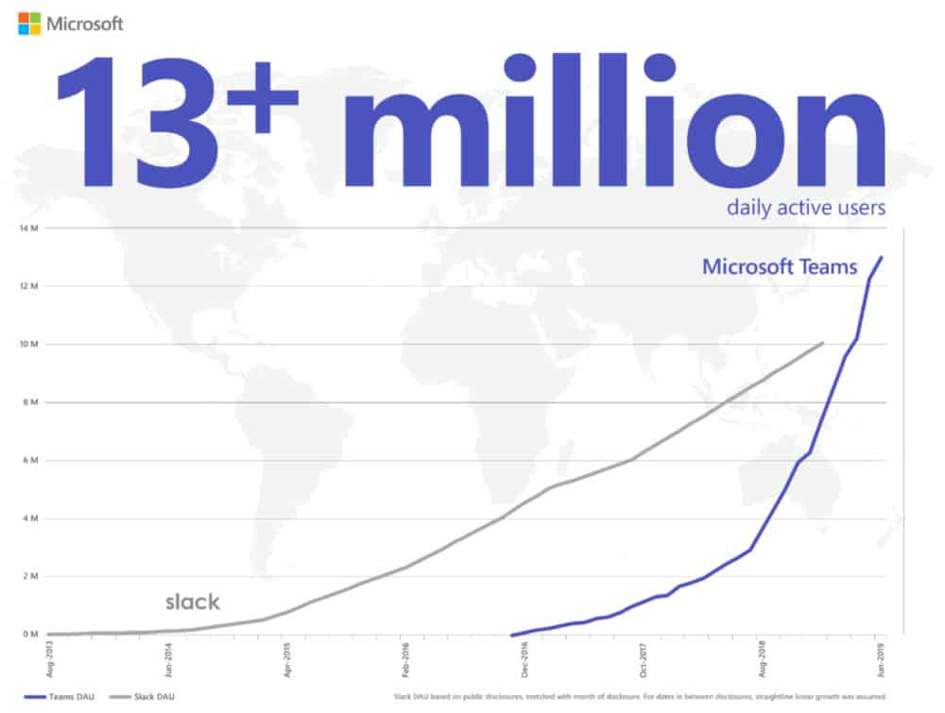
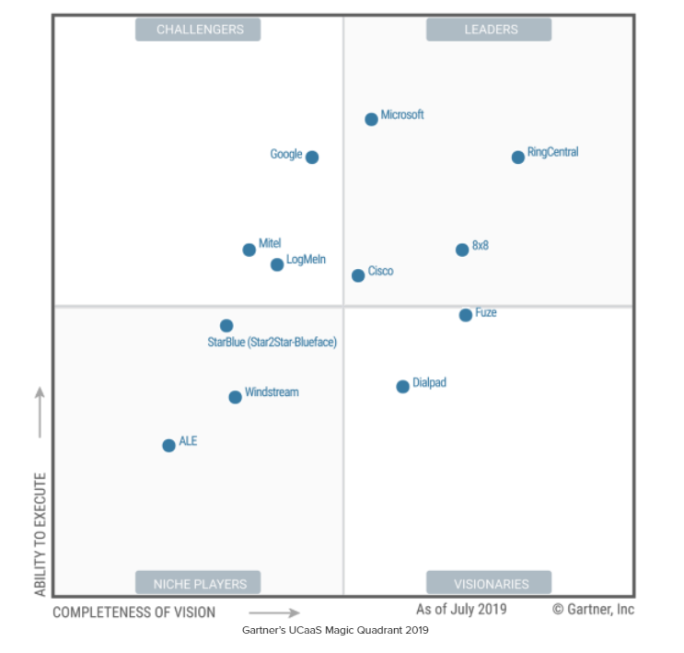
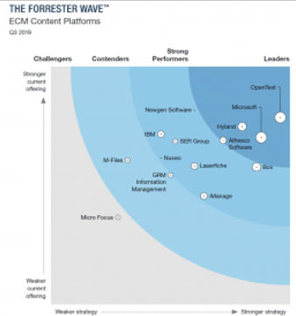

Leader
Communication
Leader
Collaboration
Leader
Teamwork

Slide 7
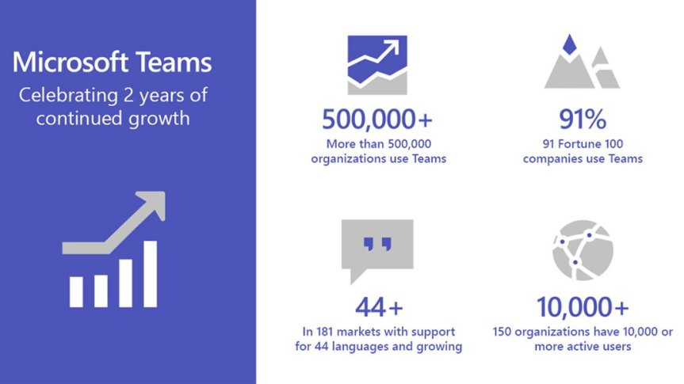
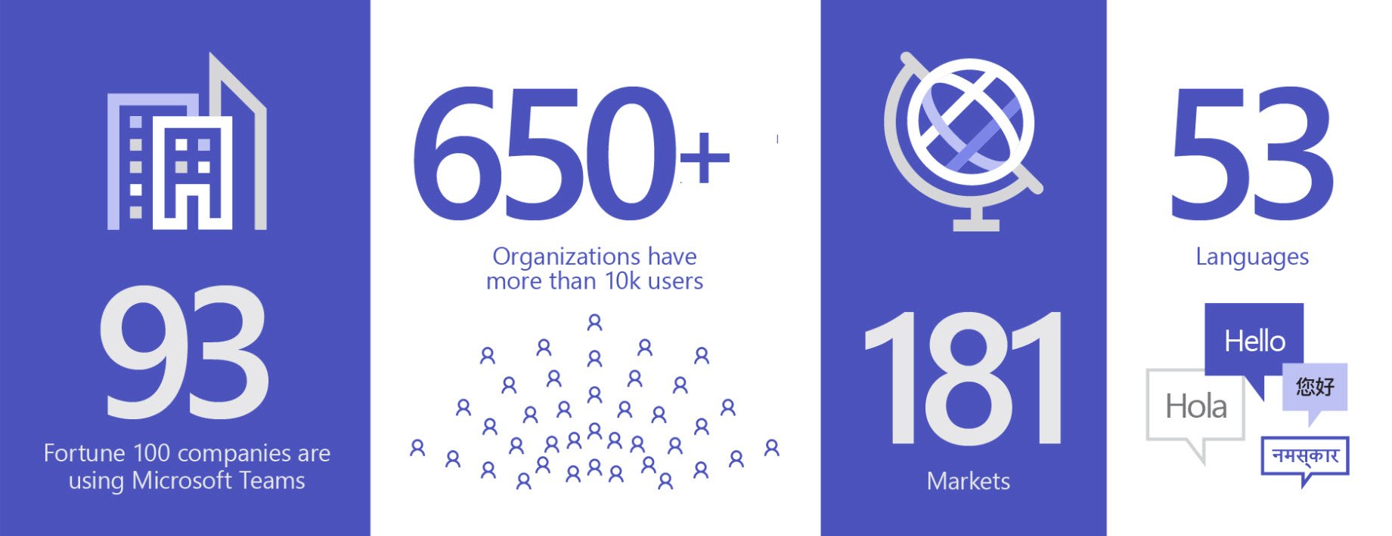
A Year On
2020
Hands on Labs
Source: Microsoft 365 Blog, Teams At 3, 16/03/2020

Slide 8



Growth of Teams
11/19 - 05/20
20 mil
44 mil
75 mil
120%
7 Days
900M
Nov 2019
Mar 2020
May 2020
Increase in 4 months
+12 Million
Minutes of meeting and calling per day
Source: Microsoft 365 Blog, Teams At 3, 16/03/2020

Slide 9

What is fuelling growth?
Private Channels
Microsoft Whiteboard in Meetings
Linux Client
Enhanced File Experience
App and Channel Pinning
App Catalogue
Functionality Adds 2019 - 2020
Other Factors
Resonates
Strategy
Community
Covid 19
Tags
Voice Administration in the TAC
Native Federation in Chats
Read Receipts | Hide Teams
Live Captions in Meetings
Presenter and Attendee Controls
Shared System Audio
Advisor for Teams
Meeting Participant Pinning
Focus Time
Content Cameras
Personal Apps in Mobile Client
Priority Notifications
Channel Moderation
Network Planner
Shifts Time Clock
Information Barriers
Announcements | Praise
Meeting Options and Control Bar
Proximity Join | Busy on Busy

Slide 10
Many organisations are not reaching their potential
High Productivity
Customise and Enhance
SPFX
Power Platform
OOBE
Security (I.e. Intune, CAS)
Apps (I.e. 400 pre-packaged apps)
Calling (I.e. Phone System) and Devices
Meetings (I.e. Audio Conferencing)
Low Productivity
Chat & Files (I.e. Group & Federated Chat, Co-authoring)
Application
Platform

Slide 11







Pivoting Narratives
Teams has limits - use it as the platform to solve your Teamwork needs
Hub
Collaboration
Security
Act
On business needs which can’t be solved by OOBE functionality and build low code no code applications
Automate
Processes and workflows which take the Team time freeing up time to focus on more productive and creative work
Analyse
Team data with visualisations and insights to make better, faster, data driven decisions
Assign
Virtual Agents to handle and answer your Teams questions
OOBE
Customise and Enhance

Slide 12






The Challenge
Adam
Teams doesn’t have the ability to let us know more about the members of the team.
It would be good to see their bios and their current responsibilities
Amanda
We could really do with something that could help us capture the meeting as people do not always send follow up emails
Vesku
It would be amazing if we could add a welcome message when someone joins the Team
The current experience isn’t good enough
Juan
We need to be kept up to date on the Power Platform
There is a lot of Twitter posts we are missing that have great content the Team could use
Chris
We need to get better oversights on Microsoft 365
I need a quick to reference information I can see within our Team
Yannick
We need to be able to see where our customers are in terms of their Teams workloads
I can’t easily tell and compare

Slide 13



Solution 1: Build a Canvas App
Create and Save the Canvas App
Download as a Zip file
Upload to Teams
Configure as a Personal App or Tab in Teams Channel
Adam
Teams doesn’t have the ability to let us know more about the members of the team.
It would be good to see their bios and their current responsibilities
Use Cases
Team Building & Orientation
Training and Instruction Manual
Product Portfolio

Slide 14
Solution 2: Use an existing Canvas App
Get the ms.app file
Open the app in Power Apps an save
Download as a Zip file
Upload to Teams
Configure as a Personal App or Tab in Teams Channel
Amanda
We could really do with something that could help us capture the meeting as people do not always send follow up emails
Use Cases
Meetings with the Team
Meetings with others in the organisation
Meetings with Guests

Slide 15
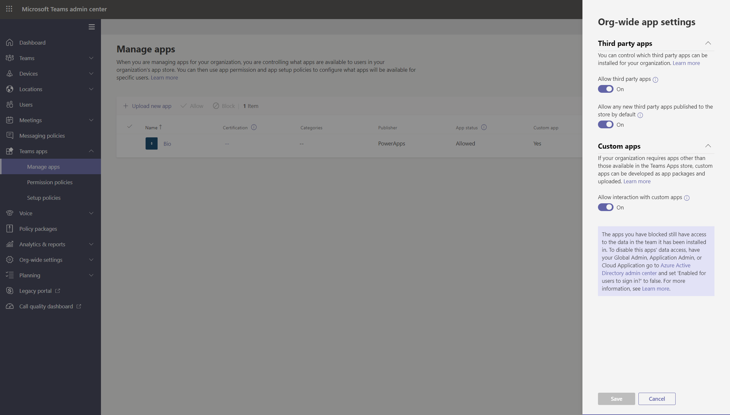
Get ready for Power Apps
Enabling the Teams Environment for Power Apps
Org Wide App Settings
App Permissions Policies
App Setup Policies

Slide 16


Three Calls to Action: Power Apps
Start today
Leverage sample apps and community apps to get started
Identify and foster makers
Continue learning with MS Learn and Power Platform Fundamentals

Slide 17
Solution 3: Build Flow with Teams Actions
Add Flow as a Personal App or a Tab in the Team
Build a Team flow based upon Teams Triggers
Add a user to the Team
Vesku
It would be amazing if we could add a welcome message when someone joins the Team
The current experience isn’t good enough
Saved time writing a message
Saved time with orientation

Slide 18


Solution 4: Build Flow with Adaptive Card
Add Flow as a Personal App or a Tab in the Team
Design the adaptive card
Build a Team flow based upon Twitter Trigger and the adaptive card action
Await posts
Juan
We need to be kept up to date on the Power Platform
There is a lot of Twitter posts we are missing that have great content the Team could use
Saved time checking Twitter
Captures all posts - can respond if needed

Slide 19



Other examples
Unlimited use cases
Good to know or have
Teams Flow Templates
Teams Triggers and Actions
The applications you use in Teams
How to build a flow
A Test environment
Form responses into Channels
Approvals
Planner notifications for task completions
Alerts
Daily weather forecast
Meeting Reminders

Slide 20


Three Calls to Action: Power Automate
Start today
Test and build flows using Teams today. Procure a test environment
Perform a time and motion study with the Team
Continue learning with MS Learn and Power Platform Fundamentals

Slide 21



Solution 5: Install Microsoft 365 Usage Analytics
Install M365 Usage Analytics in Power BI Dashboard
Enable the use of Microsoft 365 data in the admin portal via reports
Connect to your data with your Tenant ID from Azure AD and OAuth2
Wait for data to populate
Configure as a Tab in Teams Channel
Chris
We need to get better oversights on adoption in Microsoft 365
I need a quick to reference information I can see within our Team
Targeted work rollouts
Highlights strategic need

Slide 22

Solution 6: Power BI Workspace and Report
Upload Excel to Team
Create Power BI Workspace
Create and Populate Power BI Report
Add as a Teams Tab
Yannick
We need to be able to see where our customers are in terms of their Teams workloads
I can’t easily tell and compare
Targeted migration strategy
Focuses metrics and goals

Slide 23
Three Calls to Action: Power BI
Start today
Get hands on a build a report from a simple excel spreadsheet
Push for a culture of data driven decisions
Continue learning with MS Learn and Power Platform Fundamentals

Slide 24
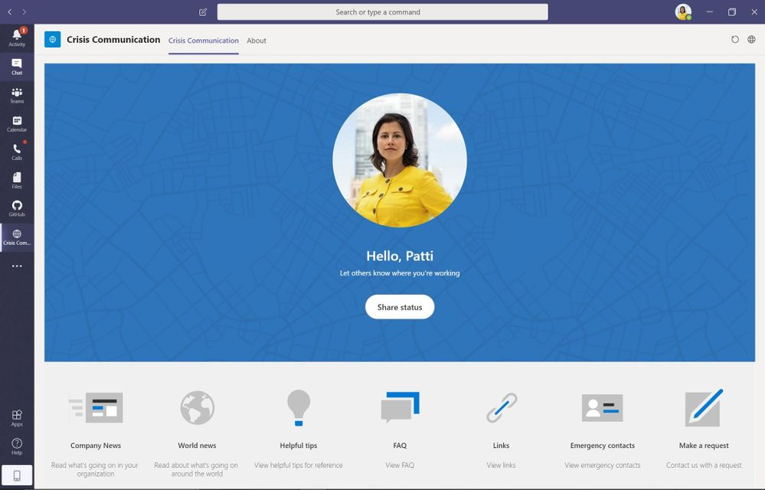
Combine
Use Power Apps, Automate and BI
User-friendly experience to connect users with information about a crisis
2 x Power Apps
3 x Flows
1 x Power BI Dashboard
Data housed in SPO
Surfaced in Teams

Slide 25
Many organisations are not reaching their potential
High Productivity
Customise and Enhance
SPFX
Power Platform
OOBE
Security (I.e. Intune, CAS)
Apps (I.e. 400 pre-packaged apps)
Calling (I.e. Phone System) and Devices
Meetings (I.e. Audio Conferencing)
Low Productivity
Chat & Files (I.e. Group & Federated Chat, Co-authoring)
Application
Platform

Slide 26
Insight
High Productivity
Customise and Enhance
Power Platform
Making data driven decisions
Automating low level tasks
Acting by making apps based on business need
OOBE
Security
Communicating & Collaborating
Apps
Calling
Meetings
Low Productivity
Chat & Files

Slide 27
Call to Action
The many things you can do to get started
Leverage sample apps and community apps to get started
Test and build flows using Teams today. Procure a test environment
Get hands on a build a report from a simple excel spreadsheet
Identify and foster makers
Perform a time and motion study with the Team
Push for a culture of data driven decisions
Continue learning with MS Learn and Power Platform Fundamentals
Continue learning with MS Learn and Power Platform Fundamentals
Continue learning with MS Learn and Power Platform Fundamentals

Slide 28
Returning to Outcomes
Value
Scenarios
Call to action
1
2
3

Slide 29











Thank you
What’s next?
07/07/2020
Commsverse
MS-700: Managing Microsoft Teams Exam Prep
08/07/2020
Commsverse
The Flipped Meeting
07/10/2020
TeamsFest
Keynote
microsoft365pro.co.uk

